Slide 1

SPEECH RECOGNITION
Angad Singh (20070124006)
Divyam Dinker (20070124011)
Aditya Srivastava (20070124003)
Prerna Singh (20070124077)
Aniket Singh (20070124078)

Slide 2
OUTLINE
Motivation/Purpose of Project
Background information/Related works
Algorithms
Proposed Method/Flowchart.
Program Code
Results
Summary
Future Work
References

Slide 3
MOTIVATION
Verbal communication is the most common means of communication. Speech recognition system basically translates spoken languages into text.
There are various real life uses of speech recognition systems:
Digital assistants (Siri, Google Assistant)
Remove language barriers.
Banking
Healthcare

Slide 4
MOTIVATION
That doesn’t mean this valuable piece of technology isn’t
accompanied by it’s demerits.
Lack of Accuracy and Misinterpretation
Time Costs and Productivity
Accents and Speech Recognition
Background Noise Interference
This technology is still in its development stage but given present circumstances, like language barriers , illiteracy etc, it’s likely to grow and improve rapidly in due time.

Slide 5
BACKGROUND INFORMATION/ RELATED WORKS
The first speech recognition technology was “Audrey”, a system designed by Bell Laboratories in the 1950s which was able to recognize only 9 digits. In 1962, the shoebox’ technology was able to understand 16 words in English.
In 1970, U.S. Department of Defense funded DARPA SUR program. As a result, Harpy’ was developed by Carnegie Mellon which had the ability to comprehend 1011 words.
A doll was also made for children in 1987; it was known as Julie’ and it could be trained by children to respond to their speech.
In 1990, the company Dragon released Dragon Dictate’ which was the world’s first speech recognition software for consumers.

Slide 6
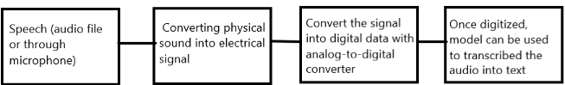
PROPOSED METHOD
Speech recognition software works by breaking down the audio of a speech recording into several individual “sounds”, analyzing each sound, using algorithms to find the most probable word that fits in that language and thus transcribing those sounds into text.
Speech recognition software uses natural language processing (NLP) and deep learning neural networks. “NLP is a way for computers to analyze, understand and derive meaning from “human languages” in a precise, useful manner". This means that the software breaks the speech down into bits it can interpret, converts it into a digital format, and analyzes the pieces of content.
From there, the software makes determinations based on programming and speech patterns, making hypotheses about what the user is actually saying. After determining what the user has most likely said, the software transcribes the conversation.

Slide 7
ALGORITHM
Step 1) Start .
Step 2) Importing Python Packages(pyaudio, pyttsx3, speech_recognition).
Step 3) Initialize the recognizer .
Step 4) Initialize a function to convert text to speech.
Step 5) Infinite loop for users to speak using “while”.
Step 6) Accepting exceptions during runtime.
6.1) Using microphone as input(source).
6.2) Print ‘listening to the user input’.
6.3) Using “google audio” to recognize the input.
Step 7) Output(the audio in text).
Step 8) Print ‘could not request result’, if audio cannot be processed.
Step 9) Print ‘no voice input, if there is no input’ .

Slide 8
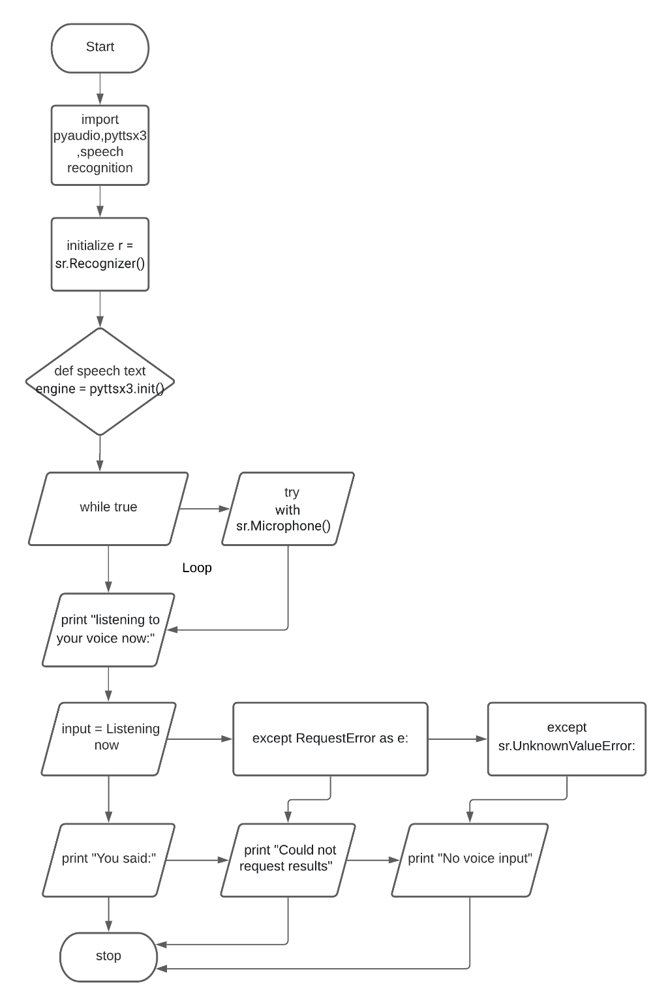
FLOW CHART

Slide 9
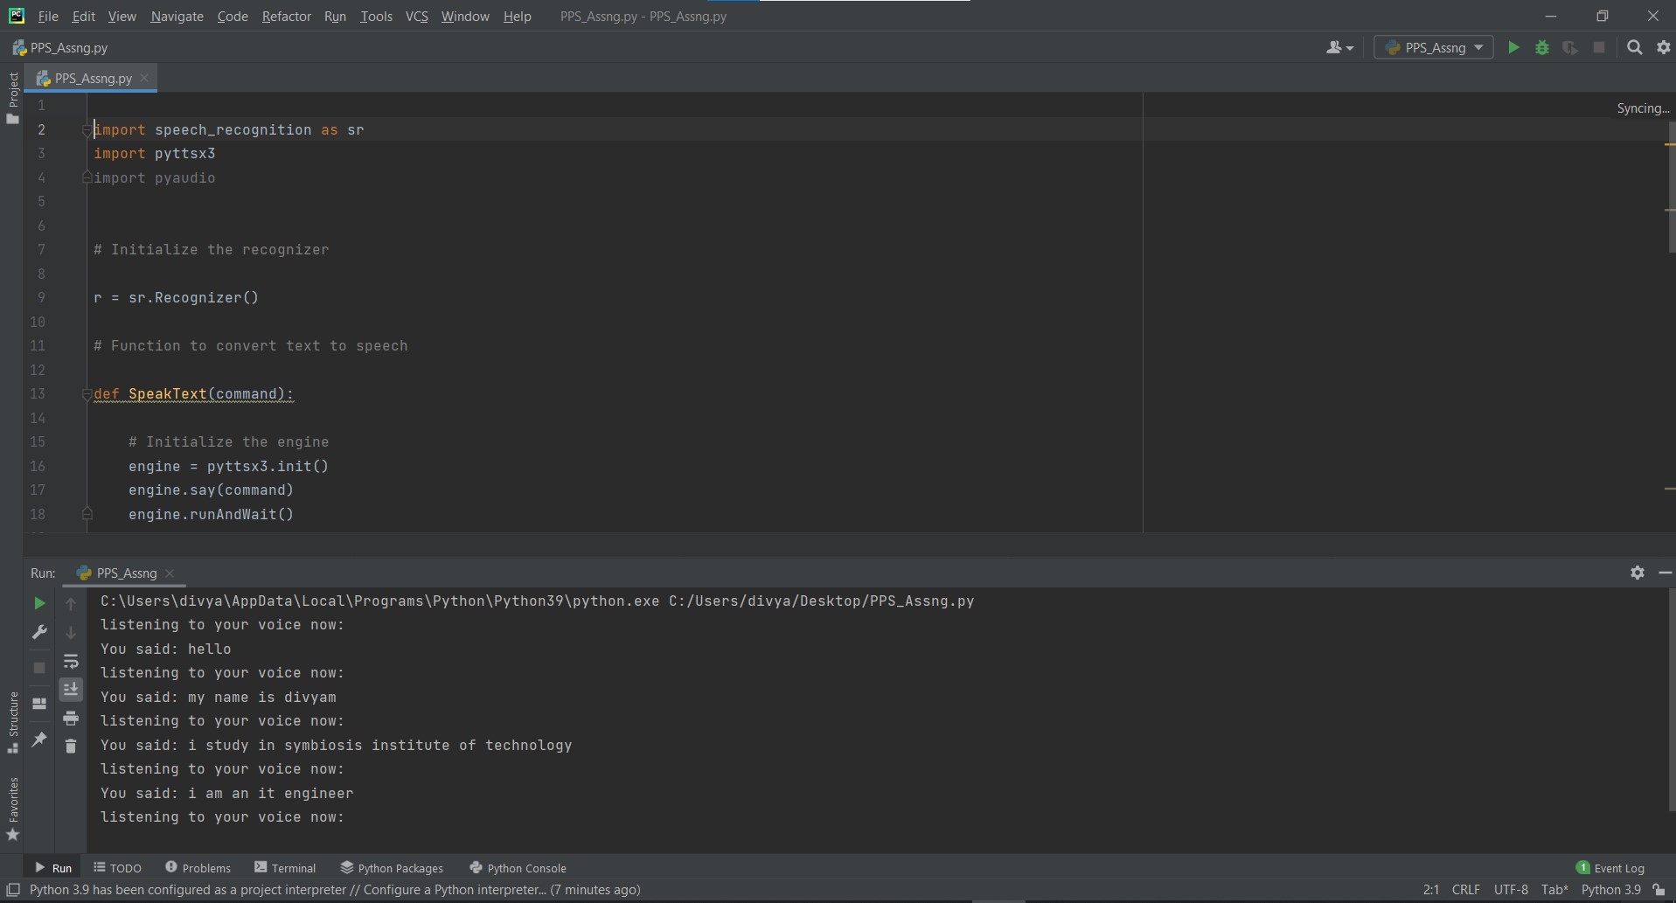
RESULTS

Slide 10
SUMMARY
Speech Recognition offers real potential, but also comes with fairly rigid and significant limitations. Designers and engineers building products and services based on speech recognition must take the limitations into account and user expectations must be managed appropriately.

Slide 11
FUTURE WORK
To enable the algorithms to understand not only what is being said but the way it is being said. Tonal inflection and all the other characteristics that add meaning to the spoken word will become a part and parcel of the process of comprehension. This may be done to determine the mood of the speaker, whether they are happy, in distress or to calculate the efficiency of how strongly or weakly one believes in their said statement. It could also work the way around and be used to change the tone of one’s response or in the case of a “security situation”, whether a response is warranted. It may also lead to a means of diagnosing a persons “mental state“, by truly understanding the sentiment behind their statements. Ultimately, concepts like sarcasm would be identifiable and play a role in understanding the ways of a person. The possibilities are limitless.

Slide 12
REFERENCES
https://www.getsmarter.com/blog/market- Trends/applications-of-speech-recognition/
https://www.rev.com/blog/advantages-and- Disadvantages-of-speech-recognition-software3)
https://www.totalvoicetech.com/a-brief- History-of-voice-recognition-technology/

